Slide 1
Federated Learning on MNIST
Minor Project Presentation
Department of Data Science and Engineering

Slide 2
Introduction
Federated Learning is a machine learning technique that enables training across multiple decentralized devices holding local data samples without sharing them. This approach is crucial for privacy-preserving model training in real-world applications like healthcare, finance, and mobile AI.

Slide 3
Objective
To implement Federated Learning on the MNIST dataset and evaluate its performance while preserving data privacy.

Slide 4
Tools and Technologies
- Python
- PyTorch
- Matplotlib
- NumPy
- Google Colab
- Jupyter Notebook

Slide 5

System Design
The dataset is divided among multiple clients. Each client trains the model on its local data, and updates are aggregated by a central server. This is repeated over multiple rounds to improve accuracy without data sharing.

Slide 6

Model Training and Evaluation
The training process involved multiple federated rounds. The model achieved a high accuracy of 94% on the MNIST test set, demonstrating the effectiveness of federated learning.

Slide 7
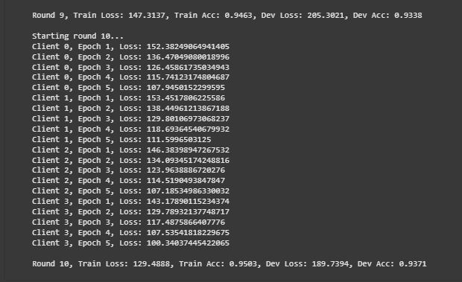
Training Logs – Round 10

Slide 8

Results and Analysis
Model accuracy improved steadily over training rounds. Visual inspection of predictions shows a high match between actual and predicted labels. Loss decreased significantly, validating the training process.

Slide 9
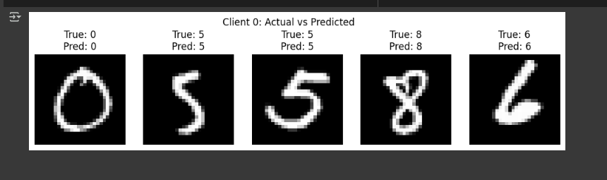
Actual vs Predicted Digits

Slide 10
Conclusion
This project successfully demonstrated the implementation of Federated Learning using the MNIST dataset. With a model accuracy of 94%, it highlights how decentralized learning can preserve privacy while delivering high performance.

Slide 11
References
1. McMahan, H. Brendan, et al. 'Communication-Efficient Learning...'
2. Kairouz, Peter, et al. 'Advances and Open Problems in Federated Learning'
3. PyTorch Documentation
4. Yann LeCun's MNIST Dataset
5. TensorFlow Federated
6. OpenAI ChatGPT
7. W3Schools Python Tutorials

